Slide 1

RRR Canteen & Café Billing
SUBMITTED TO : SUBMITTED BY:
Mr. Arpit Deo Raviraj Singh Chouhan
Rashika Asati
Rohit Kumar Lavvanshi

Slide 2
ACKNOWLEDGEMENT
“I would like to express my special thanks of gratitude to my teacher Mr. Arpit Deo who gave us the golden opportunity to do this wonderful project on the topic Billing System , which also helped me and my group in doing a lot of Research and i came to know about so many new things I am really thankful to them.
Secondly i would also like to thank my friends who helped me a lot in finalizing this project within the limited time frame.”

Slide 3
Introduction
As the name the suggest our project is about calculating bill of customers and management of employees in the Canteen.
Our billing system provides access to employees as well as the manager.
The manager can access all the employee details like name, employee Id, password, contact etc.
Manager has also the access to remove or add a employee.
The employees can login into the system by their employee id and password.

Slide 4
Requirements
We need Python3 installed in our pc.
We also need sqlite3 for database management.
Required libraries:
Tkinter
Re
Random
String
Time
Datetime

Slide 5
Why Billing System….?
Preparing an invoice or bill format which is fixed, neat, professional, and error-free.
The invoice prepared by them possess a full description of the expanses that the customers have been charged for.
Efficiently keep the accurate record of the customer and rates.
Track the material present i.e. inventory in your Canteen or shop.
Improves the efficiency of the staff.

Slide 6
explanation
Before moving ahead, one should be familiar to the technicalities i.e. flow of working, types of work to be done, how to do it etc.
At the very first level, you have to login according to your designation i.e. Manager or Employee.
If the manager login, he/she can access to inventory, employees, and invoices.
In the inventory manager can see the product details and can update, add, or delete the products.

Slide 7
Explanation(cont.)
Then in employees manager can add, update, or remove a particular employee.
Next in the invoices, manager can see the bills of each customer.
Now, if a employee login’s to the system he/she can only able to calculate the bills and can search for a particular bill with the help of bill number.

Slide 8
Problems faced
Problem 1 :
As our project is created using GUI(Graphical user interface) package we have to write similar codes for many times to create a single window which is time consuming and can have number of errors. Even for writing a single line in our window we have to write code for multiple times in different windows.
Solution:
To solve the problem of rewriting the same code we use images. Images will provide the shaded background with our needy elements.

Slide 9
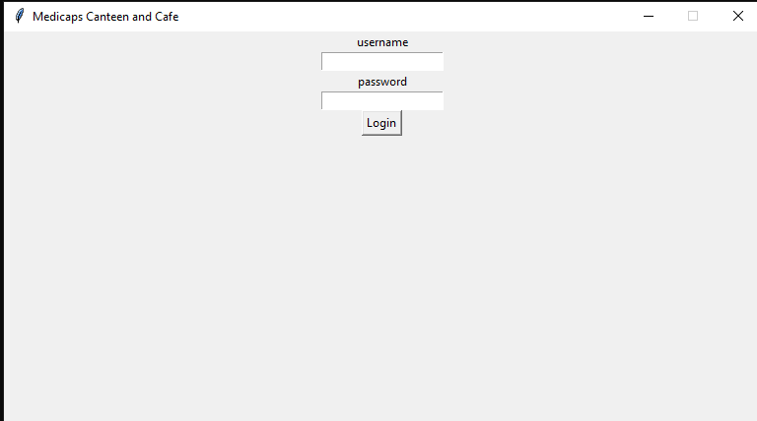
Without images

Slide 10
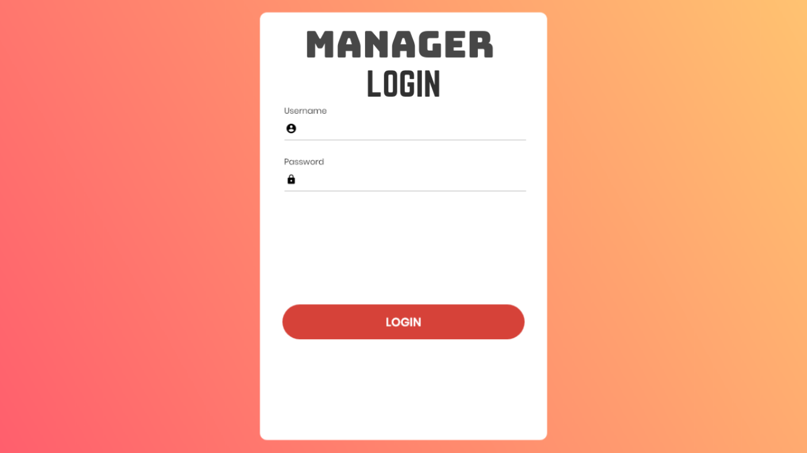
With imaGES

Slide 11
Problems faced cont.
Problem 2:
Generating an employee Id is one of our problems. We are unable to generate Id’s randomly.
Solution:
For generating a random employee id we uses 2 libraries i.e. string and random.
String library will provide alphabets and digit. And using random we will generate random employee I’d.

Slide 12
Problems faced cont.
Problem 3: Storing data and accessing it whenever we required is a major concern to use. It is difficult to store in python codes as we have different costumers and all have different data according to their bill.
Solution: we used SQL for storing data and fetching it whenever it is required. Using SQL we can simply access, store and update our data accordingly.

Slide 13
Important terms used
DBMS:A Database Management System (DBMS) is software designed to store, retrieve, define, and manage data in a database.
SQL: SQL stands for Structured Query Language is the most common language for extracting and organising data that is stored in a relational database. A database is a table that consists of rows and columns. SQL is the language of databases. It facilitates retrieving specific information from databases that are further used for analysis.
GUI:A graphical user interface (GUI) is a type of user interface through which users interact with electronic devices via visual indicator representations.

Slide 14
Code run

Slide 15
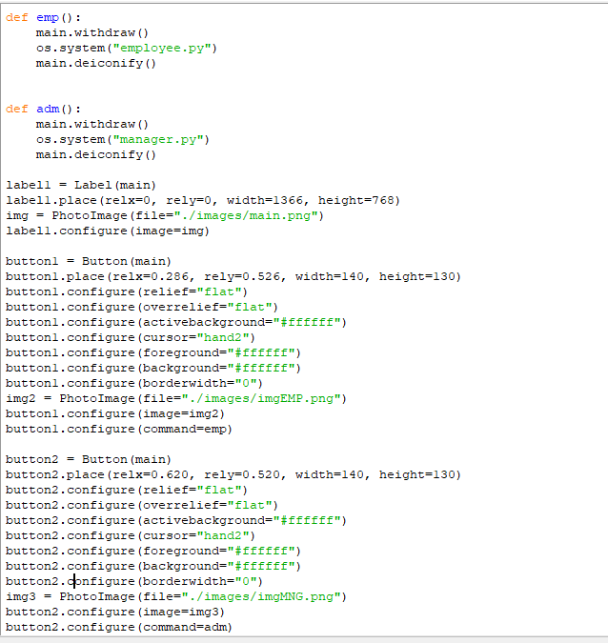
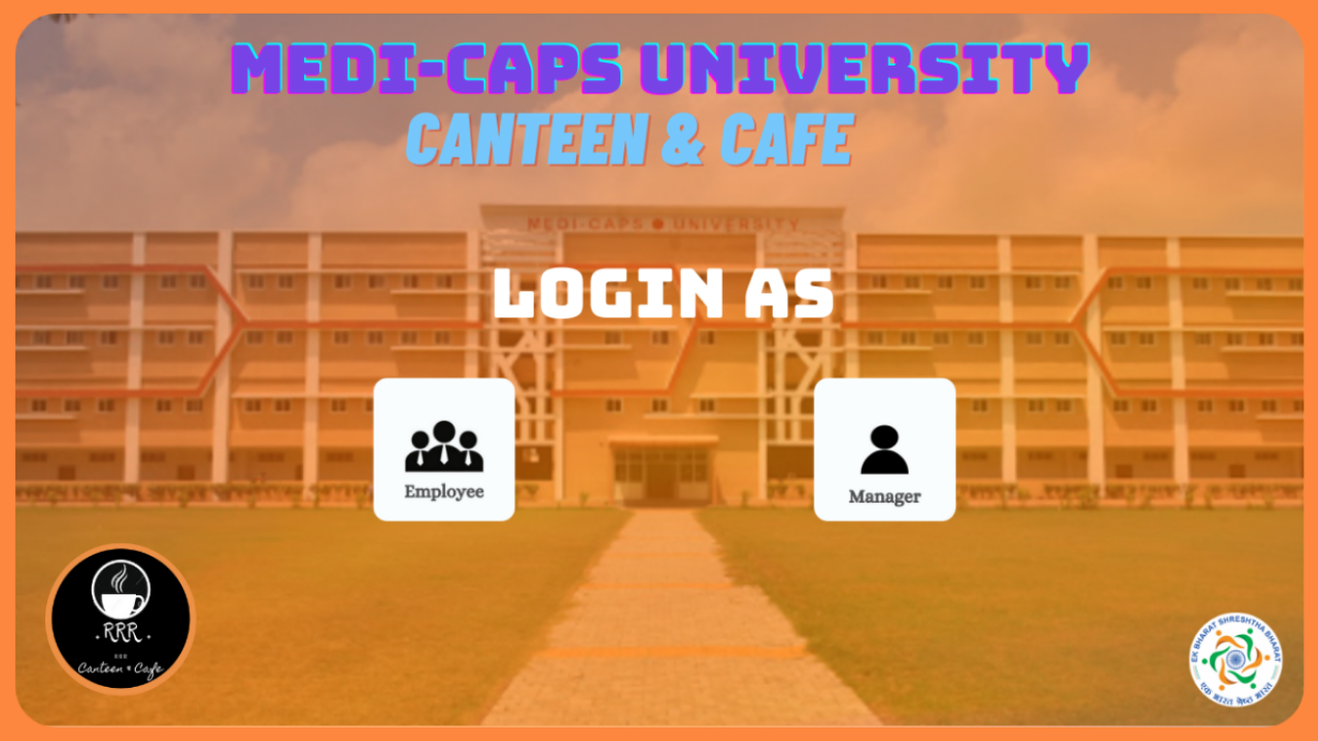
code explanation

Slide 16
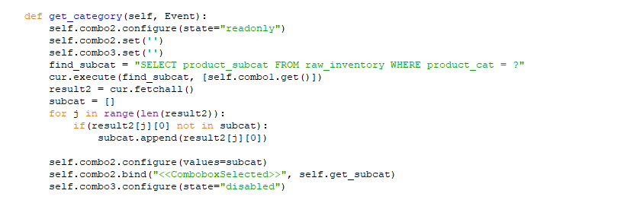
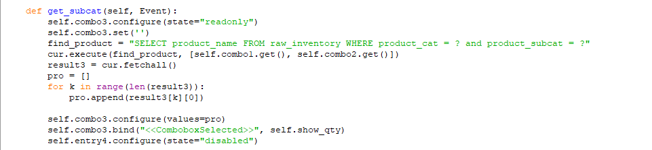
To get the category and subcategory of the item.

Slide 17
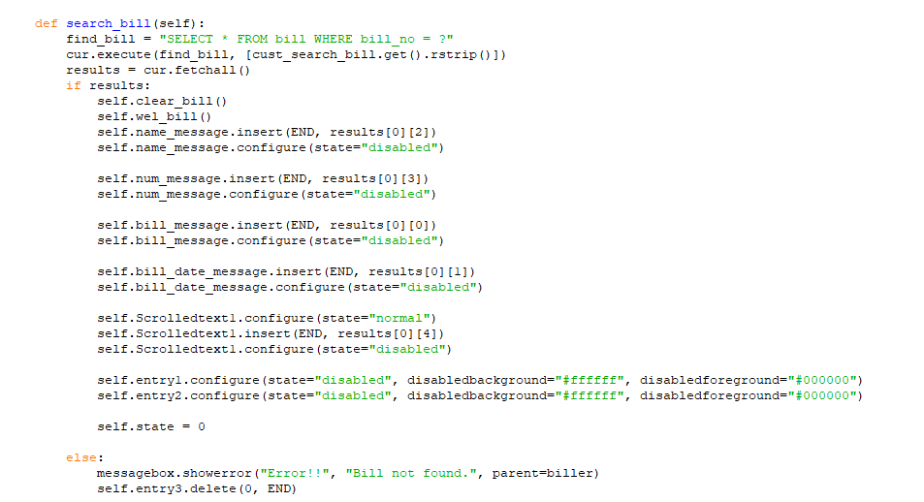
For searching a bill using bill number.

Slide 18
System architecture
LOGIN
Employee
Manager
Bill Creation
Bill searching
Employees
Invoices
Inventry
About Us

Slide 19
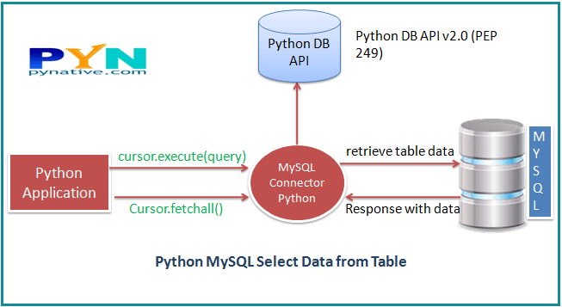
Idea behind the project

Slide 20
Advantages
You can effectively and easily able to create a bill.
Bills of customers are stored for a long period of time. Even after 1 or 2 month you can check your bill with your bill number.
Accurate amount will be calculated with the system.
Easily accessible inventory.
You can manage all employee at a time. Or can change the employee if needed.

Slide 21
THANK YOU

Slide 22
ANY QUESTIONS

